Slide 1
Data Mining
Chapter 4
Association Analysis: Basic Concepts
Introduction to Data Mining, 2nd Edition

Slide 2
Association Rule Mining
A very popular DM method in business
Finds interesting relationships (affinities) between variables (items or events)
Part of machine learning family
Employs unsupervised learning
There is no output variable
Also known as market basket analysis

Slide 3
Association Rule Mining
Input: the simple point-of-sale transaction data
Output: Most frequent affinities among items
Example: according to the transaction data…
“Customer who bought a lap-top computer and a virus protection software, also bought extended service plan 70 percent of the time."
How do you use such a pattern/knowledge?
Put the items next to each other
Promote the items as a package
Place items far apart from each other!

Slide 4
Association Rule Mining
A representative application of association rule mining includes
In business: cross-marketing, cross-selling, store design, catalog design, e-commerce site design, optimization of online advertising, product pricing, and sales/promotion configuration
In medicine: relationships between symptoms and illnesses; diagnosis and patient characteristics and treatments (to be used in medical DSS); and genes and their functions (to be used in genomics projects)
…

Slide 5
Association Rule Mining
Are all association rules interesting and useful?
A Generic Rule: X ⇒ Y [S%, C%]
X, Y: products and/or services
X: Left-hand-side (LHS)
Y: Right-hand-side (RHS)
S: Support: how often X and Y go together
C: Confidence: how often Y goes together with X
Example: {Laptop Computer, Antivirus Software} ⇒ {Extended Service Plan} [30%, 70%]

Slide 6
Association Rule Discovery: Definition
Given a set of records each of which contains some number of items from a given collection;
Produce dependency rules which will predict occurrence of an item based on occurrences of other items.
Rules Discovered:
{Milk} --> {Coke}
{Napkin, Milk} --> {Banana}

Slide 7
Definition: Frequent Itemset
Itemset
A collection of one or more items
Example: {Milk, Bread, Diaper}
k-itemset
An itemset that contains k items
Support count (σ)
Frequency of occurrence of an itemset
E.g. σ({Milk, Bread,Banana}) = 2
Support
Fraction of transactions that contain an itemset
E.g. s({Milk, Bread, Banana}) = 2/5
Frequent Itemset
An itemset whose support is greater than or equal to a minsup threshold

Slide 8
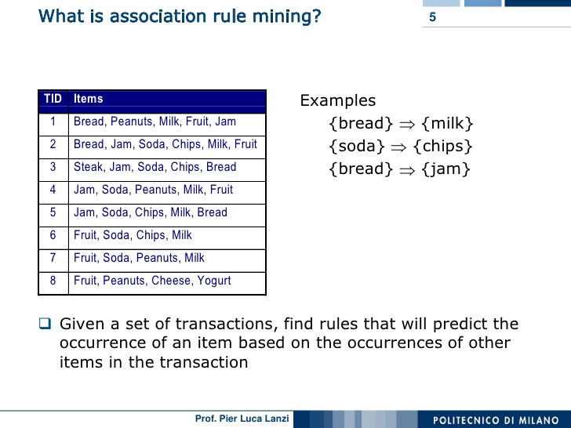

Slide 9
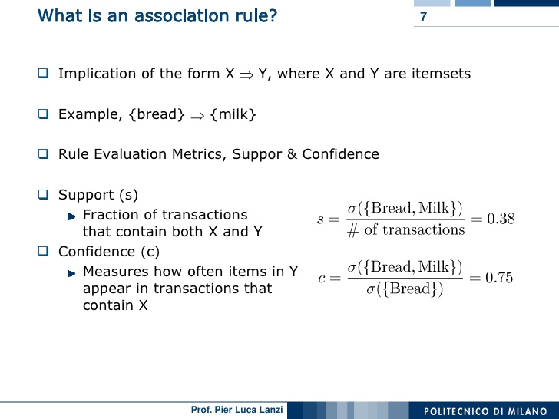

Slide 10
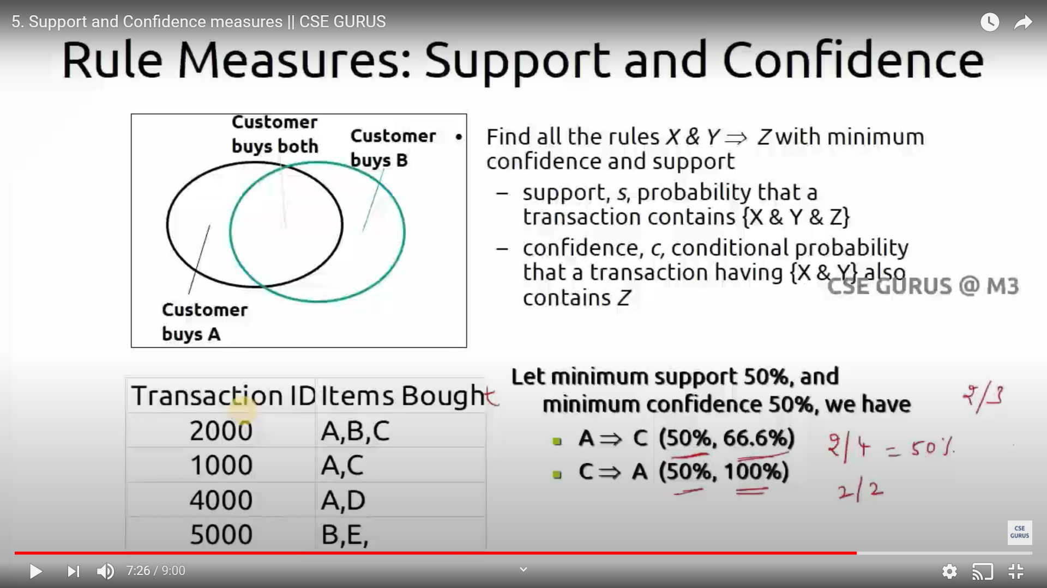

Slide 11
Association Rule Mining
Algorithms are available for generating association rules
Apriori
Eclat
FP-Growth
+ Derivatives and hybrids of the three
The algorithms help identify the frequent item sets, which are then converted to association rules

Slide 12
Apriori Algorithm
Apriori is a popular method which can be used for association rules learning.
It identifies the item sets that appear together. i.e., there is an appearance relationship between specific items in each dataset.
It has a great applications in marketing (market basket analysis)
if the customer buy Milk, then we are highly confident that he will buy eggs.
Action: put these items close to each other in the supermarket

Slide 13
Association Rule Mining
Apriori Algorithm
Finds subsets that are common to at least a minimum number of the itemsets
Uses a bottom-up approach
frequent subsets are extended one item at a time (the size of frequent subsets increases from one-item subsets to two-item subsets, then three-item subsets, and so on), and
groups of candidates at each level are tested against the data for minimum support.
(see the figure) → --

Slide 14
Association Rule Mining Apriori Algorithm

Slide 15
Cont.
ID | Items
1 | Milk, Eggs, Bread, Butter
2 | Milk, Butter, Eggs, Ketchup
3 | Bread, Butter, Ketchup
4 | Milk, Bread, Butter
5 | Bread, Butter, Cookies
6 | Milk, Bread, Butter, Cookies
7 | Milk, Cookies
8 | Milk, Bread, Butter
9 | Bread, Butter, Eggs, Cookies
10 | Milk, Butter, Bread
11 | Milk, Bread, Butter
12 | Milk, Bread, Cookies, Ketchup
Assume that we have the following items list comes from a transactions dataset.
Find which items which often sold together.
Two keys
support: the popularity of the item
confidence: how confident are we to say if item x is sold then item y will be sold by the same customer

Slide 16
Cont.
ID | Items
1 | Milk, Eggs, Bread, Butter
2 | Milk, Butter, Eggs, Ketchup
3 | Bread, Butter, Ketchup
4 | Milk, Bread, Butter
5 | Bread, Butter, Cookies
6 | Milk, Bread, Butter, Cookies
7 | Milk, Cookies
8 | Milk, Bread, Butter
9 | Bread, Butter, Eggs, Cookies
10 | Milk, Butter, Bread
11 | Milk, Bread, Butter
12 | Milk, Bread, Cookies, Ketchup
Assume that the support S = 33% and confidence rate Cr = 65%.
We start by making frequency list for the items in the dataset

Slide 17

Cont.
1-item set
Item | Frequency
Milk | 9
Bread | 10
Butter | 10
Eggs | 3
Ketchup | 3
Cookies | 5
We keep the items that satisfies the minimum support count
Frequent 1-item
Item | Frequency
Milk | 9
Bread | 10
Butter | 10
Cookies | 5

Slide 18
Cont.
Find all the possible two items from the Frequent 1-item set
Frequent 1-item
2-item set
Item | Frequency
Milk | 9
Bread | 10
Butter | 10
Cookies | 5
ID | Items
1 | Milk, Bread
2 | Milk, Butter
3 | Milk, Cookies
4 | Bread, Butter
5 | Bread, Cookies
6 | Butter, Cookies

Slide 19
Cont.
Find the frequent 2-item set by eliminating items that do not satisfy the minimum support level
Frequent 2-item
2-item set
Item | Frequency
Milk, Bread | 7
Milk, Butter | 7
Bread, Butter | 9
Bread, Cookies | 4
Item | Frequency
Milk, Bread | 7
Milk, Butter | 7
Milk, Cookies | 3
Bread, Butter | 9
Butter, Cookies | 3
Bread, Cookies | 4
3-item set
Item | Frequency
Milk, Bread, Butter | 6
Milk, Bread, Cookies | 1
Milk, Butter, Cookies | 3
Bread, Butter, Cookies | 2

Slide 20
Cont.
Find the frequent 3-item set by eliminating items that do not satisfy the minimum support level
3-item set
Item | Frequency
Milk, Bread, Butter | 6
Milk, Bread, Cookies | 1
Milk, Butter, Cookies | 3
Bread, Butter, Cookies | 2
Frequent 3-item set
Item | Frequency
Milk, Bread, Butter | 6

Slide 21
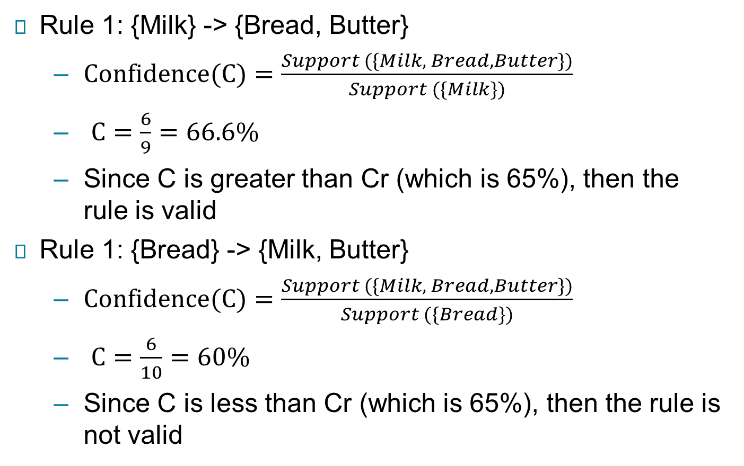
Cont.
a

Slide 22
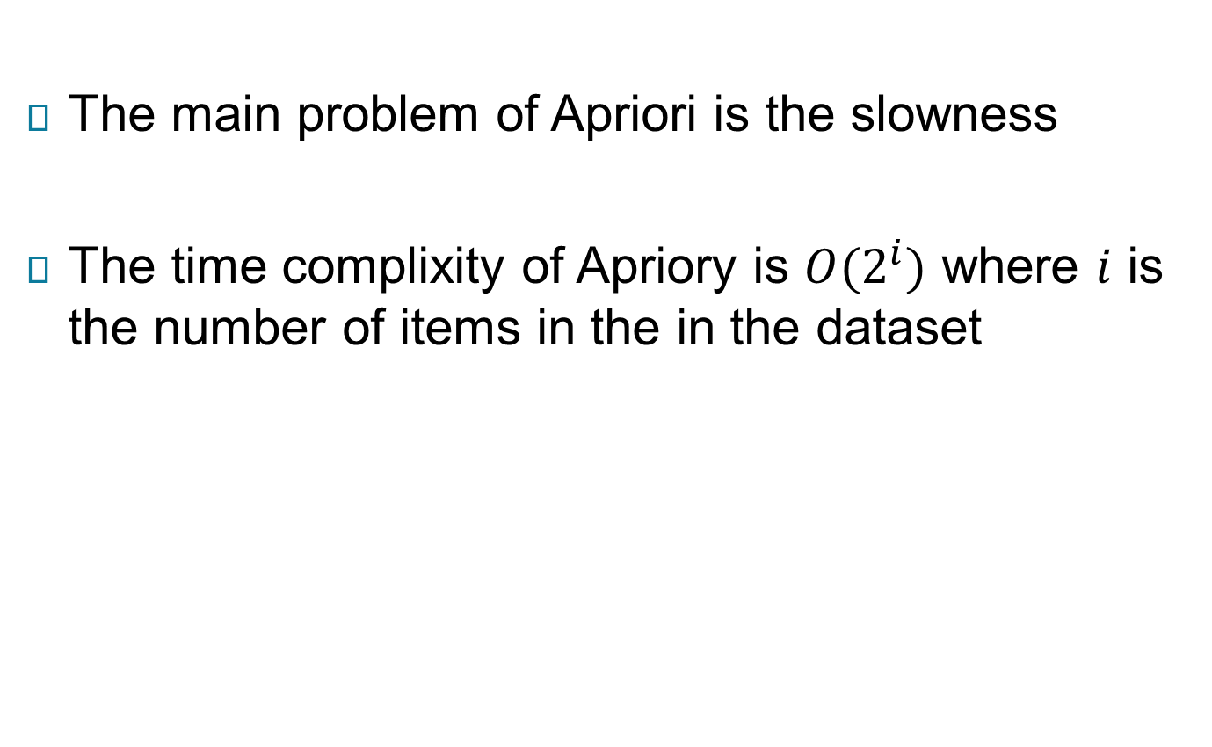
Limitations of Apriori

Slide 23
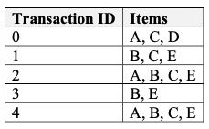
Example
Assume that we have the following items list comes from a transactions dataset.
Find which items which often sold together.
Assume that the support S = 40% and confidence rate Cr = 60%.

Slide 24
Equivalence Class Transformation (ECLAT) Algorithm
ECLAT is also known as vertical Apriori.
The reason of this name is because ECLAT perform the analysis along transactions instead on items.
ECLAT is faster than Apriori algorithm. WHY?
(homework), do your research to answer this question.

Slide 25
ECLAT Algorithm
Assume we have the same transactions as before (same support):
ID | Items
1 | Milk, Eggs, Bread, Butter
2 | Milk, Butter, Eggs, Ketchup
3 | Bread, Butter, Ketchup
4 | Milk, Bread, Butter
5 | Bread, Butter, Cookies
6 | Milk, Bread, Butter, Cookies
7 | Milk, Cookies
8 | Milk, Bread, Butter
9 | Bread, Butter, Eggs, Cookies
10 | Milk, Butter, Bread
11 | Milk, Bread, Butter
12 | Milk, Bread, Cookies, Ketchup

Slide 26
Cont.
First step, we change the format of the items to be vertical.
ID | Items
1 | Milk, Eggs, Bread, Butter
2 | Milk, Butter, Eggs, Ketchup
3 | Bread, Butter, Ketchup
4 | Milk, Bread, Butter
5 | Bread, Butter, Cookies
6 | Milk, Bread, Butter, Cookies
7 | Milk, Cookies
8 | Milk, Bread, Butter
9 | Bread, Butter, Eggs, Cookies
10 | Milk, Butter, Bread
11 | Milk, Bread, Butter
12 | Milk, Bread, Cookies, Ketchup
Remove the sets that have support less than 4
Item | IDs
Milk | 1, 2, 4, 6, 7, 8, 10, 11, 12
Eggs | 1, 2, 9
Bread | 1, 3, 4, 5, 6, 8, 9, 10, 11, 12
Butter | 1, 2, 3, 4, 5, 6, 8, 9, 10, 11
Ketchup | 2, 3, 12
Cookies | 5, 7, 12

Slide 27
Cont.
Find the two frequent item set (2-item set)
Frequent 1-item set
Frequent 2-item set
Item | IDs
Milk | 1, 2, 4, 6, 7, 8, 10, 11, 12
Bread | 1, 3, 4, 5, 6, 8, 9, 10, 11, 12
Butter | 1, 2, 3, 4, 5, 6, 8, 9, 10, 11
Item | IDs
Milk, Bread | 1, 4, 6, 8, 10, 11, 12
Milk, Butter | 1, 2, 4, 6, 8, 10, 11, 12
Bread, Butter | 1, 3, 4, 6, 8, 9, 10, 11

Slide 28
Cont.
Find the three frequent item set (3-item set)
Item | IDs
Milk, Bread | 1, 4, 6, 8, 10, 11, 12
Milk, Butter | 1, 2, 4, 6, 8, 10, 11, 12
Bread, Butter | 1, 3, 4, 6, 8, 9, 10, 11
Item | IDs
Milk, Bread, Butter | 1, 4, 6, 8, 10, 11, 12
We can create the rules like we did in slides 21

